Slide 1
Redux intro
By Yurii Holskyi

Slide 2
Redux and why we need it?
Redux was created in 2015 by Dan Abramov and Andrew Clark. It’s similar and inspired by Facebook’s flux architecture. (https://facebook.github.io/flux/)
Redux is a popular JavaScript library for managing the state of your application. It is very common and if you are working with React, chances are — you’ve already heard about it.
For those of you who have no idea what an application state is: it is like a global object which holds information that you use for various purposes later in the app (e.g. making decisions on which components to render and when, rendering the stored data etc).
Big applications have big application states and managing them gets more and more inconvenient as your app grows. That’s why we need state management libraries like Redux.

Slide 3
Crucial patterns
1. Redux follows is called “Single Source Of Truth”, which means that we have only one place (called Store) where we store the only state for the whole application. In other words, one app — one store — one state.
2. Another pattern that Redux follows is called “immutability”. And you will find this term quite often in other frameworks and libraries as well.

Slide 4
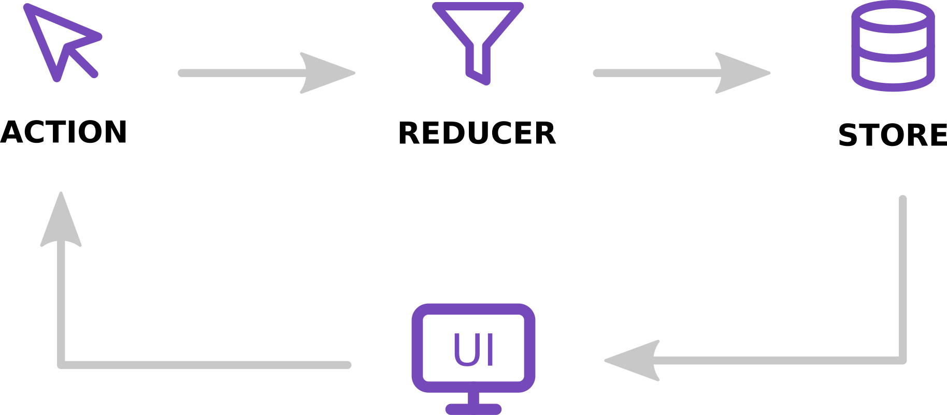
Building blocks

Slide 5
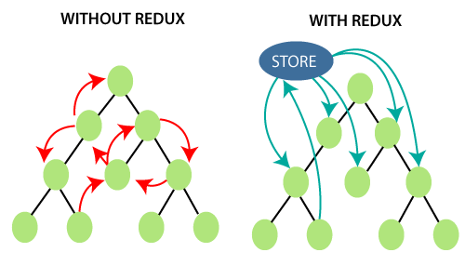
Store
Store hold the state of the application. The store is actually an object, not a class, although it may feel like one at first. It contains a few extra things other than your application’s state as well (like functions and other objects).
We can subscribe to listen to events whenever the store updates. In a non-React app, we might use this subscription to update the UI.

Slide 6
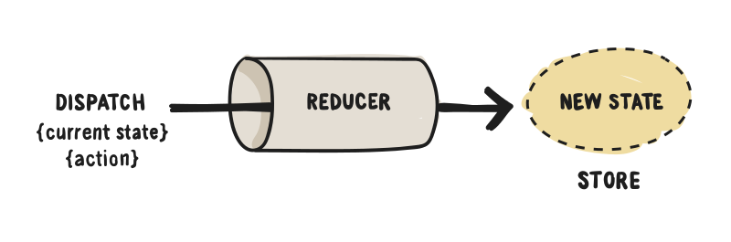
Actions
Actions are plain JavaScript objects that describe WHAT happened, but don’t describe HOW the app state changes.
We just dispatch (send) them to our store instance whenever we want to update the state of our application. The rest is handled by the reducers, which we will familiarize ourselves with in just a moment.
One important thing to remember is that Redux requires our action objects to contain a type field. This field is used to describe what kind of action we are dispatching and it should usually be a constant that you export from a file. All other fields in the action object are optional and are up to you.

Slide 7
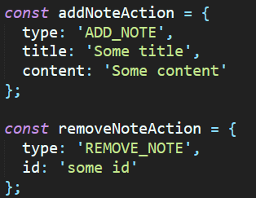
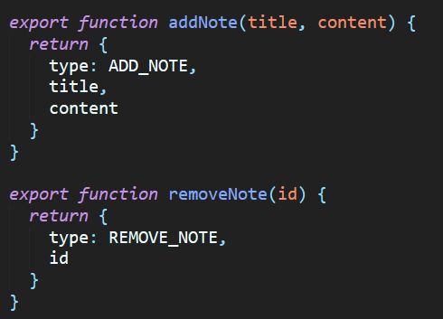
Actions + actions creators
Simple action object looks like:
But, when we need insert dynamic data, like id, titles, etc., we create a function that return object and that functions named action creators.

Slide 8
Reducers
Reducers are pure functions that define HOW the app state changes. In other words, they are used to recalculate the new application state or, at least a part of it.
Whenever we dispatch an action to our store, the action gets passed to the reducer. The reducer function takes two arguments: the previous app state, the action being dispatched and returns the new app state.
In other words, the reducer will calculate the new state of our app based on the action (and its type) we dispatched.
In a real-world application, your reducers most probably will get very complex. To deal with reducer complexity, we chunk them down in multiple, simpler reducers and later, we combine them with a Redux helper function called combineReducers.
The main reducer is conventionally called Root Reducer.

Slide 9
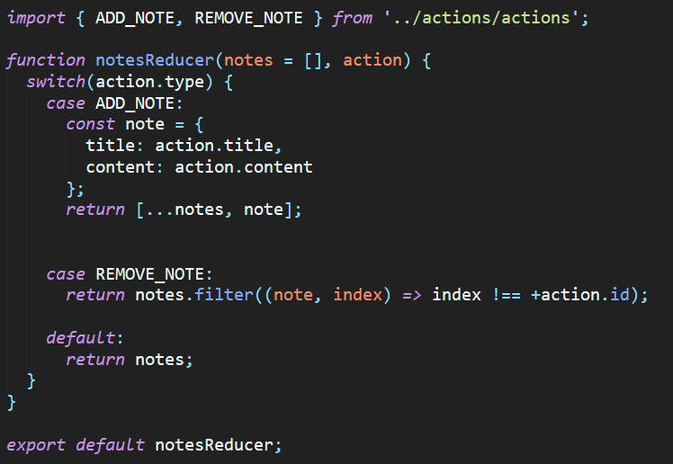
Reducer example
ADD_NOTE AND REMOVE_NOTE is just actions names.

Slide 10
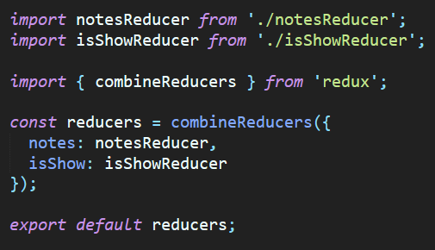
Combine reducers

Slide 11
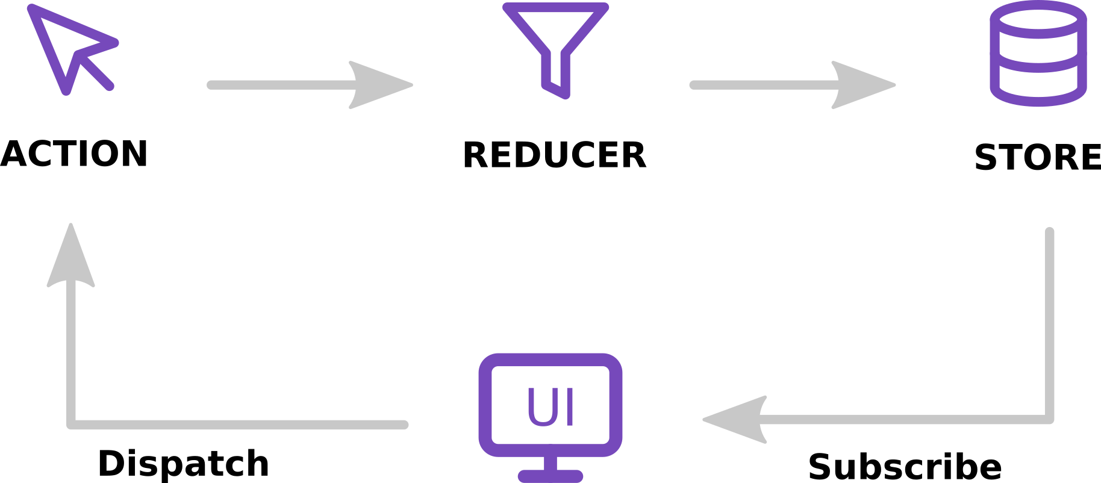
Data flow
Although it looks a bit complicated at first, the data flow in Redux is actually pretty simple.

Slide 12
Data flow
Let’s say that the user triggers an event (for example, clicks the “Add Note” button) and the app state updates (i.e. a new note is inserted into the app state). Here’s what happens under the hood:
The button click handler function dispatches an action to the store with the store.dispatch() method;
Redux passes down the dispatched action to the reducer;
The store saves the new state returned by the reducer;
Since we have subscribed to the store, the function we provided will be called and it will update the UI accordingly (i.e. append the new note in the list of notes).

Slide 13
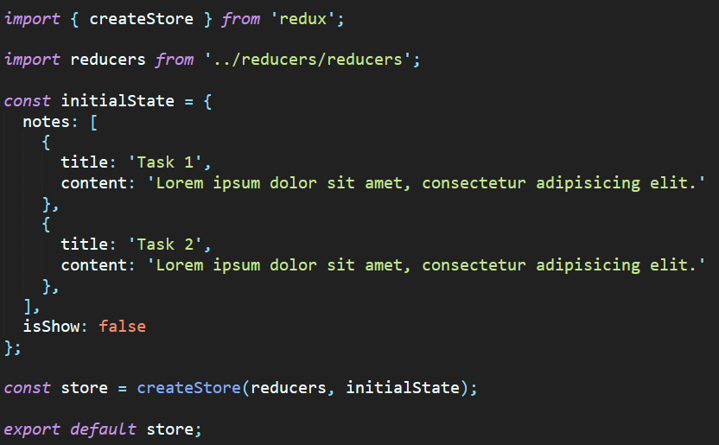
Installing and configure
To install redux we just need node.js installing on our computer.
Command: npm install redux or yarn add redux.

Slide 14
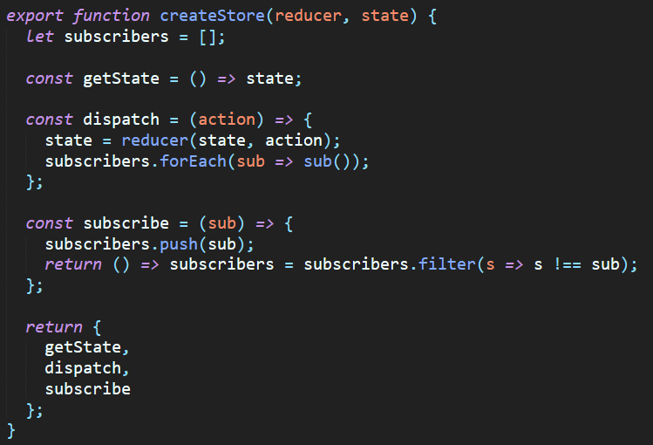
Own createStore function
We can easily create own “createStore” function which work the same as in redux library.

Slide 15
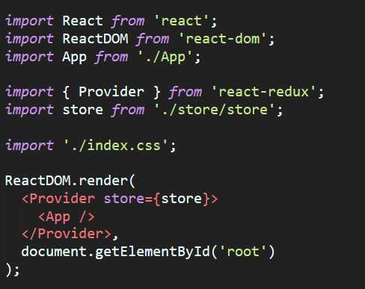
Redux + react = 🎉🎉🎉
There is a package called react-redux which we use to wire up our React components with Redux.
Command: npm install redux react-redux.
react-redux provides a React component called Provider, which makes our application store available throughout our entire application.

Slide 16
Connect HOC
react-redux provides a connect function. We use this function whenever we want to “connect” a component to Redux, i.e. make a React component interact with our Redux store.
It also takes in two optional arguments: mapStateToProps and mapDispatchToProps.
The first argument, mapStateToProps, has to do with subscribing to the store by mapping store values in our component’s properties. If we want to subscribe to the store, we provide a non-null first argument.
The second argument, mapDispatchToProps, has to do with injecting action creators in our component’s properties.
Links: https://react-redux.js.org/using-react-redux/connect-mapstate,
https://react-redux.js.org/using-react-redux/connect-mapdispatch.

Slide 17
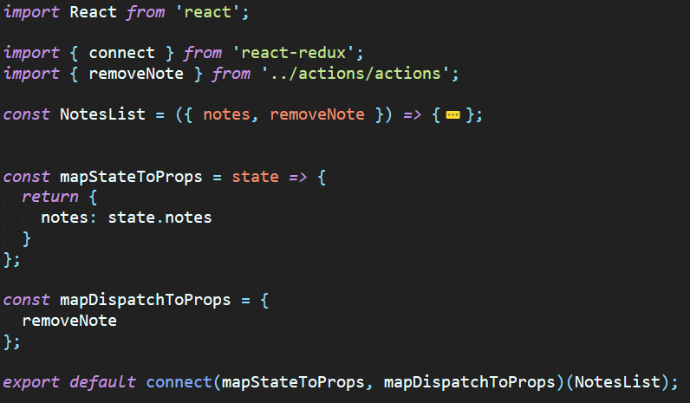
Connect example

Slide 18
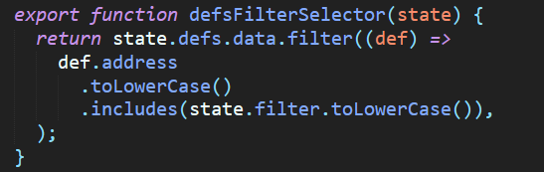
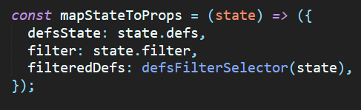
Selectors
In mapStateToProps we also can pass computed values. It’s computed values – selectors.
Selectors it’s a simple function that receive as parameter state and return computed value.

Slide 19
Async actions + redux-thunk
By default actions in Redux are dispatched synchronously, which is problem to communicate with external API. Redux allows a middleware named redux-thunk to use async actions. Also redux have another library for async action – redux-saga. https://redux-saga.js.org/docs/introduction/BeginnerTutorial.html
Redux-thunk lets you call actions creators that returns a function instead of plain object. That function receives the store’s dispatch method, which is then we used to dispatch synchronous actions inside body of function.

Slide 20
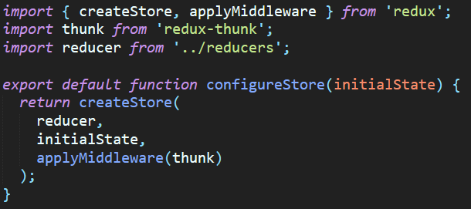
Installing and setup
To install redux-thunk, command: npm I redux-thunk or yarn add redux-thunk.

Slide 21
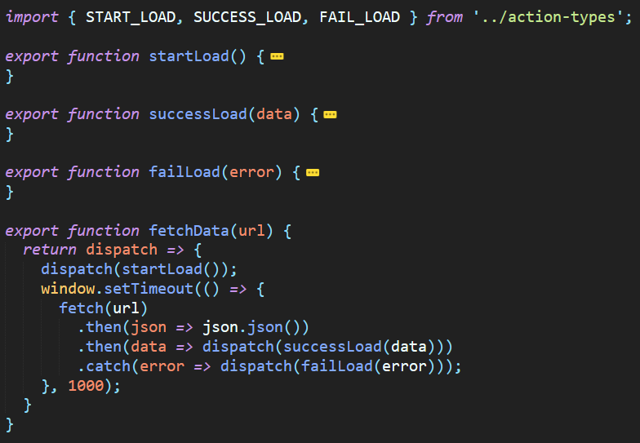
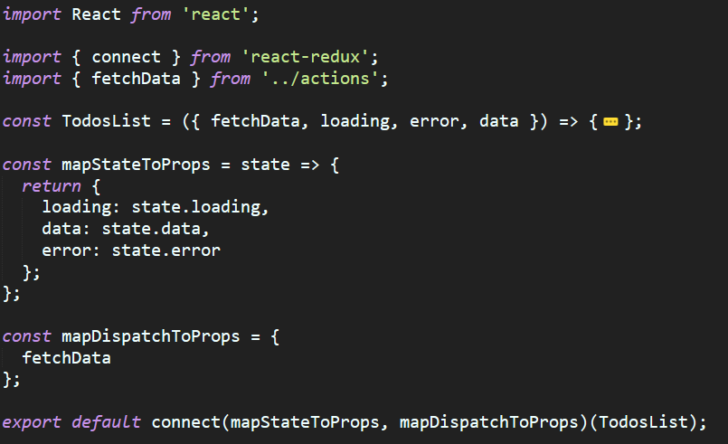
Redux-thunk example

Slide 22
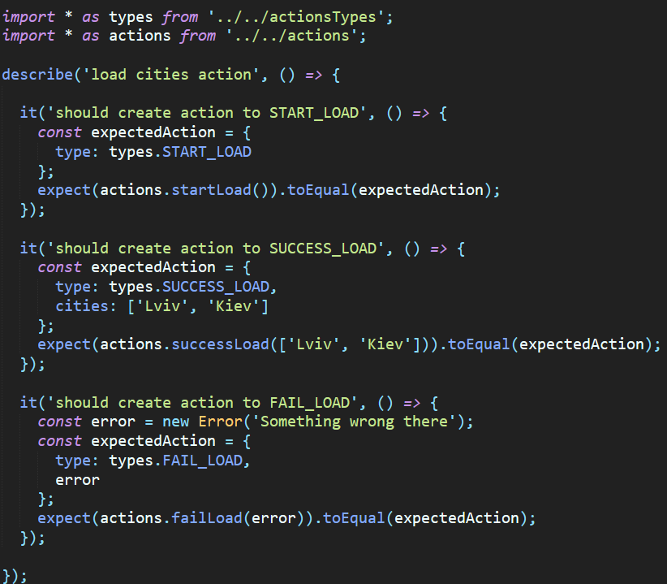
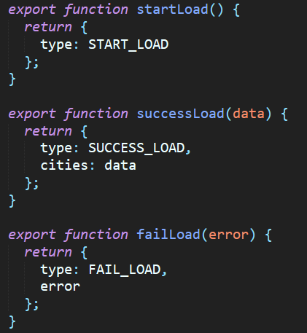
Redux testing(actions)
Testing redux actions is easy, because
action is just simple function that return
plain object. Using jest testing library

Slide 23
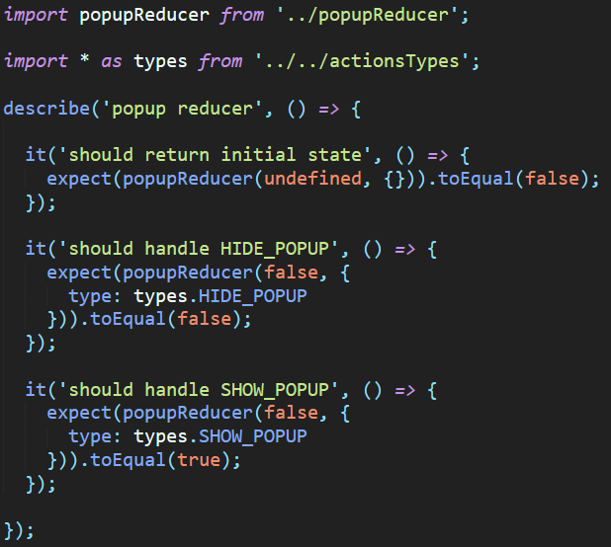
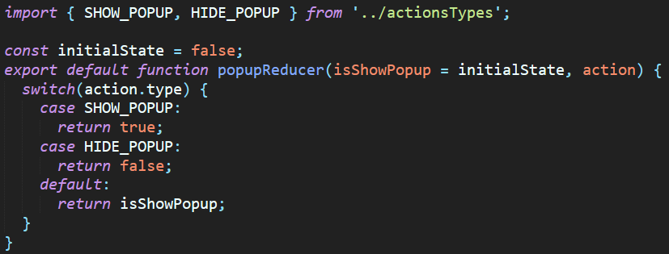
Redux testing (reducers)
Testing reducers is also very easy,
because is pure functions.

Slide 24
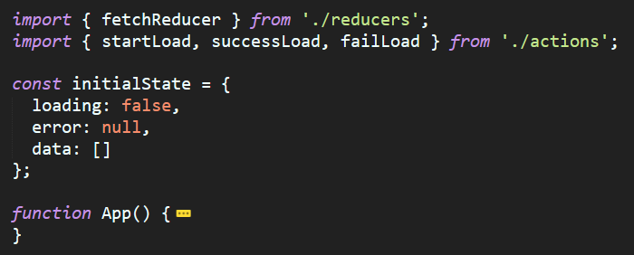
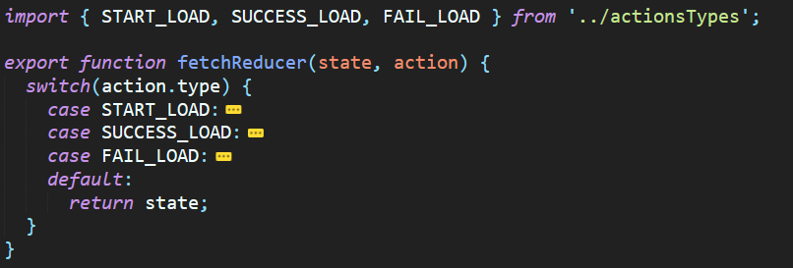
useReducer hook
React have a hook called useReducer that imitate simple redux functionality. This hook received 2 arguments: reducer function and initial state and return array with state and dispatch function.

Slide 25
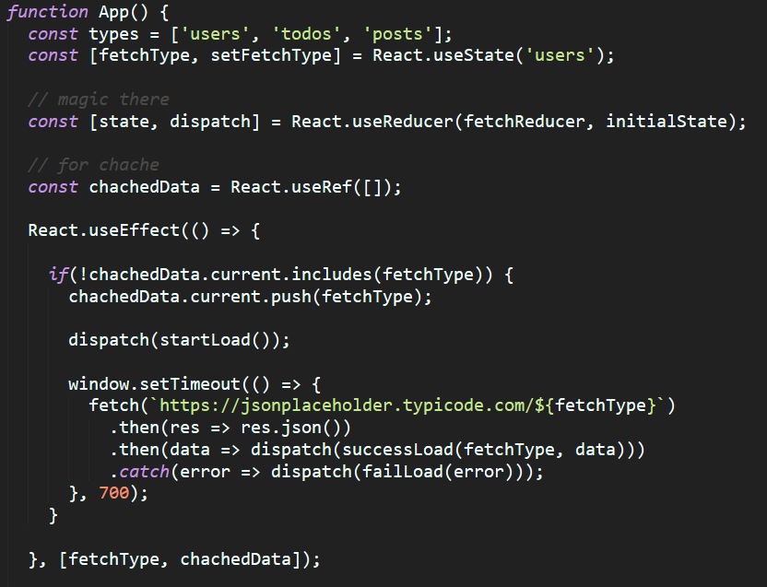
useReducer hook example

Slide 26
Sources
https://redux.js.org/;
https://egghead.io/courses/getting-started-with-redux;
https://medium.com/@netxm/testing-redux-reducers-with-jest-6653abbfe3e1;
https://alligator.io/react/testing-redux-reducers/.

Slide 27
Thank you

